Slide 1
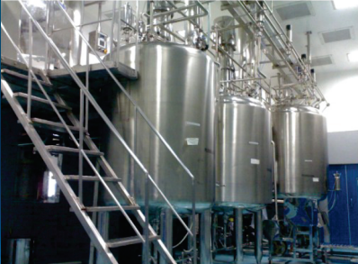
LIQUID / ORAL MANUFACTURING PLANT
Mfg.& Exp. Of Plants & Machineries for Pharmaceuticals,
Cosmetics, Chemicals food & Beverage Industries
Plot No. 1601/1,3rd Phase G.I.D.C., Vapi-396195. (Gujarat)
Email:sales@sidhipharmaequiment.com:sidhipharmaequipments@gmail.com:
Contact Person : Mr. Pravin Panchal (9924893790) Mr. Kiran Gophane (9545868896)
Website: www.sidhipharmaequipment.com

Slide 2
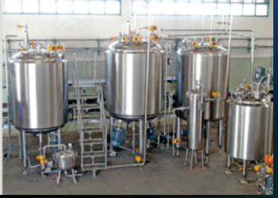
LIQUID / ORAL MANUFACTURING PLANT:
The Liquid Manufacturing Plants are ideal tools for the pharmaceutical industry for the production of Oral Liquids. It is specially designed to take care of two critical factors which directly affects the quality of the Liquids. Minimum manual handling of Liquid. Effective cleanness during manufacturing. Needless to say, it also provides the benefits of the effective manpower utilization.
Sugar Syrup Vessel
Pre - filtration Unit
Manufacturing Vessel
Filtration Unit
Storage Vessel
Control Panel
Products Piping
Working Platform
SIDDHI PHARMA EQUIPMENT Liquid Manufacturing Plant consist the following equipment and accessories.

Slide 3
Silent Features :
The Plant is designed to operated only by one operator and one helper.
All material transfers are done by vacuum or by transfer pumps.
All the vessels CGMP ( paint free construction).
The gaskets used are of silicon (food grade).
All contact parts are of S.S. 304 quality material ( SS316 provided on demand) & finished to class 4B (Mirror) finish and are crevice free. T
he entry of stirrer & high speed emulsifier are from top. In-Line Emulsifier (as per customer choice) provided on demand (Optional).
All vessels are suitable for internal pressure of 1 Kg. / Sq. cm. and hence can be sterilized. All pipes, pipe fittings and valves are of Ss304 / Ss316 ( as per customer requirement ) seamless quality, internally electro polished with tri - clover ended joints.
The entries plant is equipped with CIP & SIP connections, so that customer can use these facility, If have CIP & SIP equipment.
Advantageous\ Benefits :
Designed in accordance with cGMP requirements.
The plant is designed to be operated by one operator and helper.
Saving on precious man power costs.
No Human Touch any where up to Filling Machine hopper.

